Slide 1

Tutorials for STM32F103RB
Nicolas Barbot
2016

Slide 2
Tutorials for STM32F103RB
Create an OpenSTM32 Project
Create a STM32CubeMX Project
GPIO
UART
Timer
Analog to Digital Conversion
Digital to Analog Conversion
FLASH

Slide 3
Tutorials for STM32F103RB
Ressources
  Nucleo F103RB
    http://www.st.com/content/st_com/en/products/evaluation-tools/product-evaluation-tools/mcu-eval-tools/stm32-mcu-eval-tools/stm32-mcu-nucleo/nucleo-f103rb.html
    This page contains user manual UM1724 describing the hardware of Nucleo boards
  STM32F103RB
    http://www.st.com/content/st_com/en/products/microcontrollers/stm32-32-bit-arm-cortex-mcus/stm32f1-series/stm32f103/stm32f103rb.html
    This page contains reference manual RM0008 describing STM32F103RB
  STM32 Cube F1
    http://www.st.com/content/st_com/en/products/embedded-software/mcus-embedded-software/stm32-embedded-software/stm32cube-embedded-software/stm32cubef1.html
    This page contains UM1850 describing the HAL library
  Open STM32
    http://www.openstm32.org/HomePage
    Open STM32 is a free Eclipse plugin for programming STM32 MCU (registration needed).
  Eclipse
    https://www.eclipse.org
    Eclipse is the IDE software

Slide 4
Create an OpenSTM32 Project

Slide 5
Create an OpenSTM32 Project
Goal:
  The objective of this tutorial is to create a new project with OpenSTM32 (and eclipse) for STM32F103RB target.
  Minimal C software will be developped for the target
  Program will be downloaded and executed on the target

Slide 6
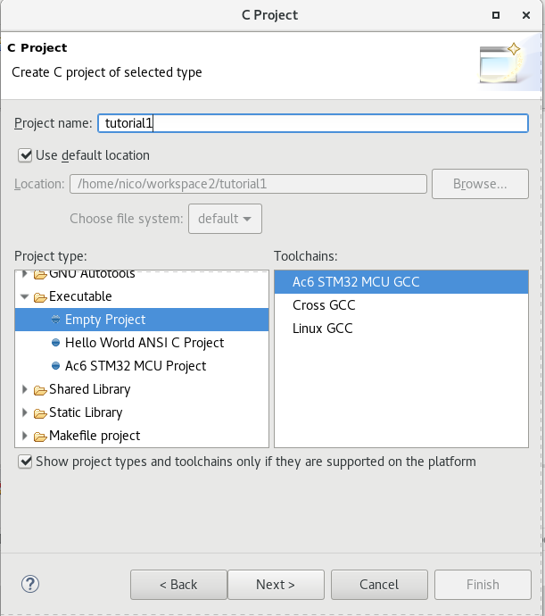
Project Creation
  File -> New Project
  Expend C/C++ Project and choose C Project then click on Next
  Choose a project name, with type Empty Project and toolchain Ac6 STM32 MCU GCC
  Click Next

Slide 7
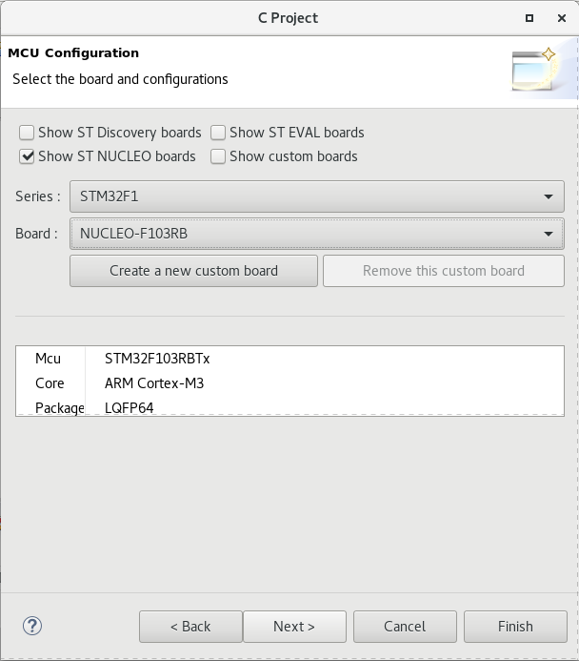
Project Creation
  Check that Debug and Release are selected then Next.
  Select your microcontroller then Next
  In this tutorial, we use a NUCLEO F103RB, set the series to STM32F1 and then choose the NUCLEO F103RB board.

Slide 8
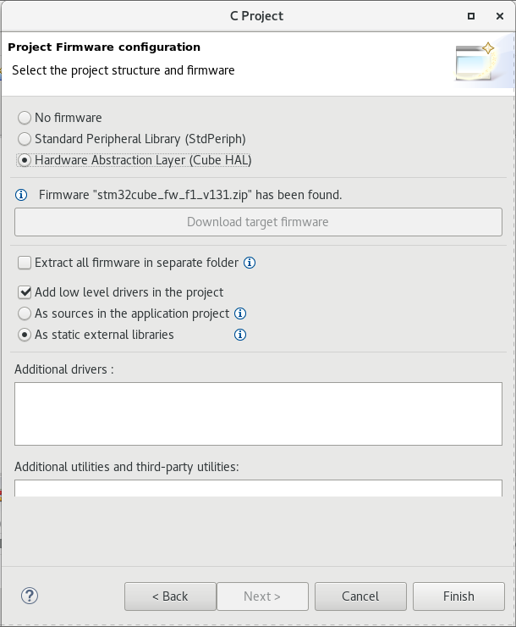
Project Creation
Select Hardware Abstraction Layer (Cube HAL).
  Our project will use HAL drivers, theses drivers ease the development process while maintaining portability across the different MCU.
  Drivers will be saved in STM32Cube directory (only for your 1st project)
Leave “As static external libraries” then Finish

Slide 9
Results
If your project have been successfully created, you should observe 2 different projects (under Project Explorer window):
  nucleo-f103rb_hal_lib which contains HAL drivers. This project will be build as a static library.
  Tutorial (your project) which contains the application code. This project depends on nucleo-f103rb_hal_lib.
Explore the tutorial project
  main.c contains main() fuction
  stm32f1xx_hal_msp.c contains the MCU specific package initialization functions for peripherals used in the user application
  stm32f1xx_it.c contains exceptions handler and peripherals interrupt service routine
  syscall.c contains some basic system calls
  system_stm32f1xx.c contains SystemInit() function which is called just before main() function.
  Startup_stm32f103xb.s contains reset handler and exception vectors

Slide 10
Building
Select the Debug configuration:
  Project -> Build configuration -> Set Active -> Debug
Build the project
  Project -> Build Project
  Compilation of the 1st project generates libnucleo-f103rb_hal_lib.a (static library)
  Compilation of the 2nd project generates tutorial.elf (executable file)

Slide 11
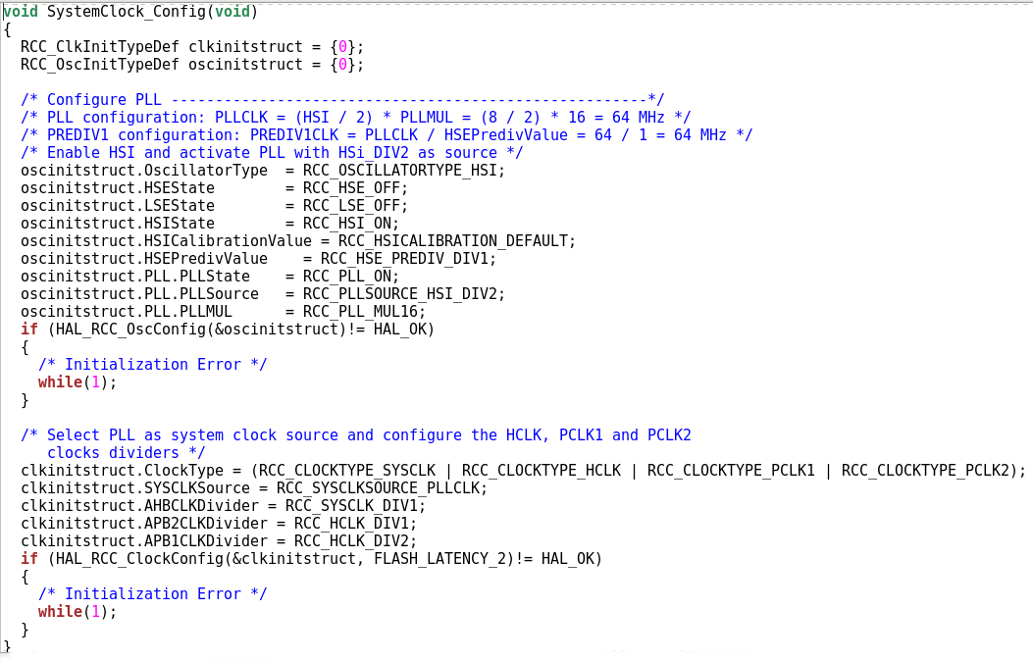
Using HAL drivers
  In the main function, call the function HAL_Init().
  By default, hardware clock is set to 8 MHz. Copy the function SystemClock_Config() in main.c file to set HCLK to 64 MHz :
  Call this function after HAL_Init()

Slide 12
Debugging
Click on Run -> Debug Configurations
Double click on Ac6 STM32 Debugging
  The debug configuration is automatically filled
The Debug Configuration have now been successfully created. For next debug sessions, simply click on:
  Run -> Debug

Slide 13
Debugging
Place a breakpoint in startup_stm32f103xb.s at line 82.
  This point corresponds to the beginning of the reset interruption. Reset interruption is called at startup and every time the reset button present on the Nucleo board is pushed
Execute the program step by step until main() function. Describe the different operations.
In main function, describe the function HAL_Init() and SystemClock_Config().

Slide 14
Conclusion
Thanks to this tutorial, you are now able to:
  Create a project with Open STM32
  Use HAL drivers as a static library linked to your programs
  Build your application
  Debug your application

