Slide 1
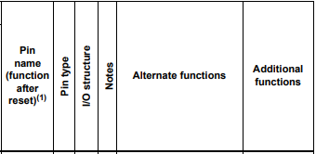
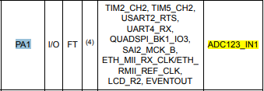
Pin Name of ADC123_IN1

Slide 2
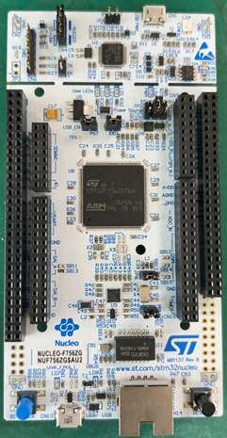
The Situation of Checking ADC123_IN1
0V
3.3V
3.3V
GND
PA1
PA1

