Slide 1
Vl53L8-> RPi

Slide 2
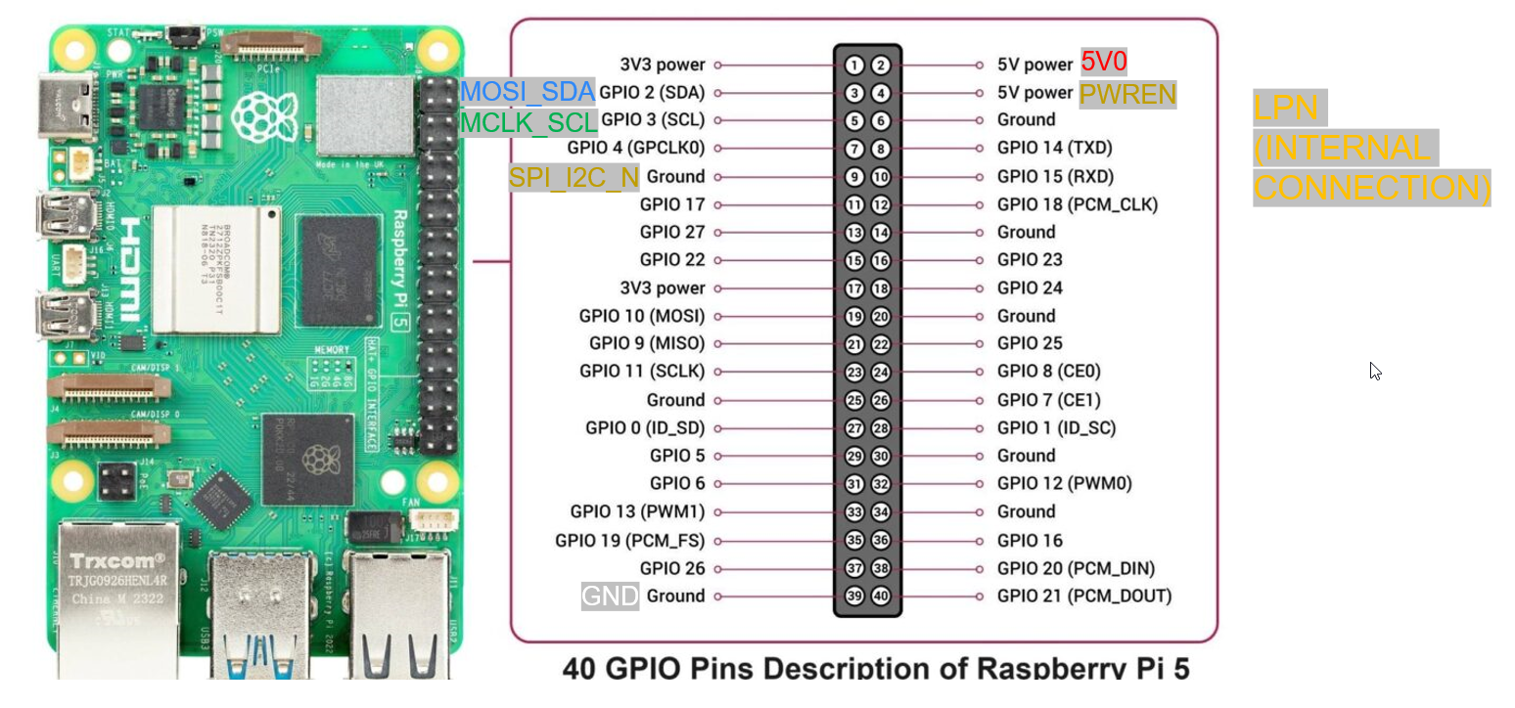

Slide 3
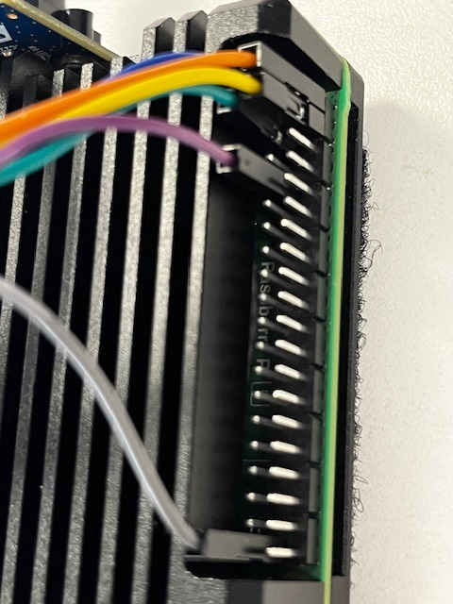
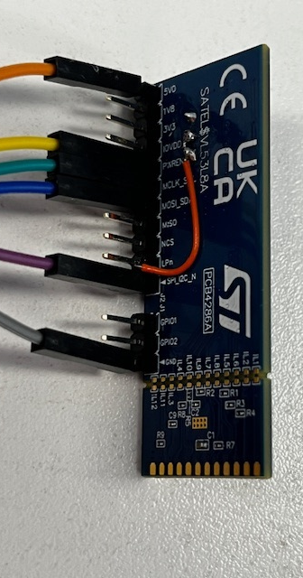
The blue is hard to see, it’s pin-2
Note –
LPn is jumpered to
J3-1V8 and the center pin.
These pins are removed from the sensor side.

Slide 4
My connections
Sensor
5v0
PWREN
MCLK/SCL
MOSI/SDA
SPI_IO/I2C
GND
Color
Orange
Yellow
Green
Blue
Purple
Gray
RPi
5v0 – pin2
5v0 – pin4
SCL – pin5
SDA – Pin3
GND – Pin9
GND – Pin39
LPN – internal J3->1v8->center

Slide 5
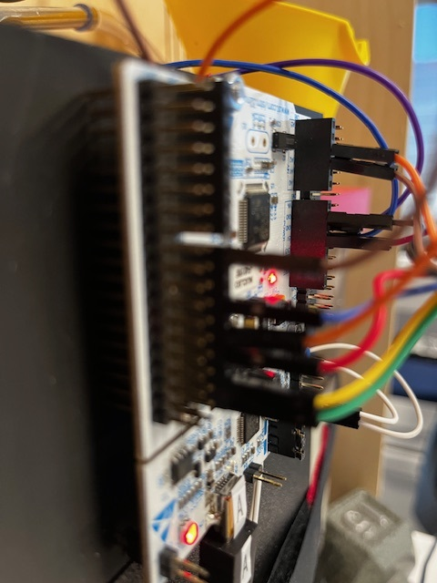
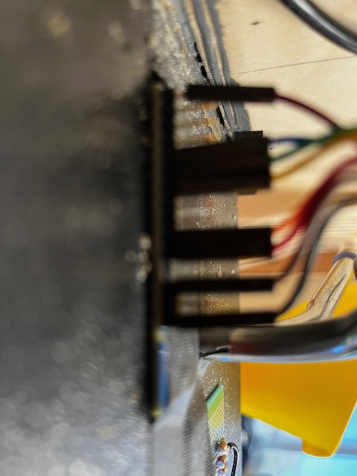
Nucleo to L8 connection
Sensor
5v0
X
X
X
PWREN
MCLK/SCL
MOSI/SDA
X
LPn
SPI_IO/I2C
X
--GAP--
GPIO1
X
GND

